Slide 1
The Pilgrim’s Progress of the Angry Mom

Slide 2
Notes:
Giant of Despair, Slough of Despond, Doubting Castle, Vanity Fair, Pit of Anger

Slide 4
The Pilgrim’s Problem

Slide 5
What is it that rules my heart?

Slide 6
We don’t parent our children
based on their behaviors.
We parent our children
based on
our interpretation of their behaviors.
Our interpretations spring from what rules our
hearts.

Slide 7
“What rules my heart?”
asks you to look inside
at the expectations you have
that are being threatened or denied.
Your motives are always centered on
protecting or defending what rules your heart.

Slide 8
What I deep down
fear or want can hijack my emotional reactions.
Anger management can definitely help in dealing with specific situations.
What rules my heart
is what I need to get
long-term help with.

Slide 9
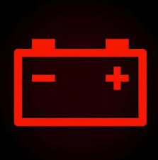
Anger is a messenger.
Anger is a “red light.”

Slide 10
Where do you go for help?
Angry people naturally talk to the wrong person.

Slide 11
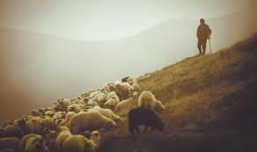
If we talk to anyone who does not point us
to the source of healing hope—
through either
common grace or God’s revealed word—
we are talking to the wrong person.
Anger will not truly resolve
until we connect
with the right person.

Slide 12
The Pilgrim’s Guide
Where do you go for help?
Are you guided by truth or lies?

Slide 13
Living Down in the Puzzle Pieces

Slide 14
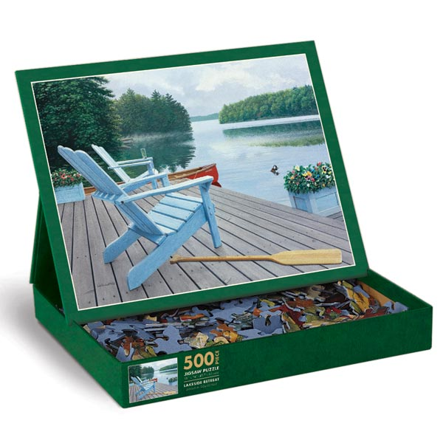
What do we need to keep in mind?

Slide 15
The Box Top View
Shows us our mission
Re-orients us to the rightful treasure of our heart
Re-aligns us with the long-term view
Helps us let out our breath and trust

Slide 16
A Biblical Box Top
My Treasure
My Mission

Slide 17
Box Top View: My Treasure

Slide 18
Being the deep treasure of my heart is too great of a burden to put on my husband and children. It is a role they will NEVER be able to fulfill—
and it is a set up for anger.

Slide 19
Box Top View: My Mission
My mission is to nurture life by the power God gives.

Slide 20
Anxious Designer

Slide 21
Trusting Tool

Slide 22
Designers become angry
as they attempt
to bend the world
to their will.
Tools are dependent
upon
the hand that holds them.

Slide 23
Are you woman enough for the job?

Slide 24
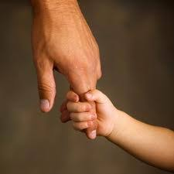
Tell yourself the truth: NO!! But God is more than enough.
Godly women are set up to navigate anger effectively when they live in this paradox of being
adequate b/c they are desperately dependent.

Slide 25
At the Root of Anger: LIES
What lies about yourself and your situation
do you need to replace with God’s truth?

Slide 26
LIE: I am alone in my anger.

Slide 27
LIE: I am alone in my anger.
TRUTH
God walks down the hall with me.
Even though I walk through the valley of the shadow of death, I will fear no evil, for You are with me. Psalm 23
Do not fear, for I am with you; do not anxiously look about you, for I am your God. I will strengthen you, surely I will help you, surely I will uphold you with My righteous right hand. Isaiah 41:10

Slide 28
LIE: I am trapped. There is no way out of this situation.
Husband, kids, in-laws, resentment, disappointment, failure…Nothing will ever change. I can’t see any other options.

Slide 29
LIE: There’s no way out. I am trapped.
TRUTH
God is merciful and promised not to give me more than I can endure.
No temptation has overtaken you except what is common to mankind. And God is faithful; he will not let you be tempted beyond what you can bear. But when you are tempted, he will also provide a way out so that you can endure it. I Corinthians 10: 13
He makes me lie down in green pastures. He leads me beside still waters. He restores my soul.
See, the Sovereign Lord comes with power, and his arm rules for him…He tends his flock like a shepherd: He gathers the lambs in his arms and carries them close to his heart; he gently leads those that have young.
Isaiah 40:10-11

Slide 30
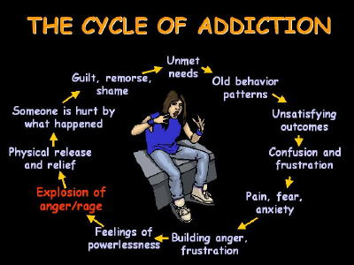
LIE: I cannot change. This anger pattern is too strong.

Slide 31
LIE: I cannot change.
TRUTH
I will measure my bondage by God’s power.
He is faithful.
He stakes himself
on bringing me through this trouble.
He leads me in paths of righteousness (change)
for His name’s sake. Ps. 23
He who began the good work within you will complete it until the day of Christ Jesus. Phil 1:6
With man this is impossible, but not with God; all things are possible with God. Mark 10:27

Slide 32
LIE: I’m not cut out for this. I’m not as good as others. I don’t have what it takes.

Slide 33
LIE: I am not cut out for this. I am not as good as others.
TRUTH
God is at work in my life. He will give me his life.
My identity in Christ is secure;
no one can diminish that.
Therefore, if anyone is in Christ, he is a new creation. The old has passed away; behold, the new has come. II Corinthians 5:17
You are his masterpiece, created in Christ for good works which He has already planned for you to do.
Ephesians 2
Are not five sparrows sold for two pennies? And not one of them is forgotten before God. Why, even the hairs of your head are all numbered. Fear not; you are of more value than many sparrows. Luke 12: 6-7

Slide 34
When it comes to anger,
you must preach God’s truth to yourself
about yourself
and about God himself---
or you’ll never change.

Slide 35
The Law of Repetition

Slide 36
Whatever script is in your mind is the one you will be subconsciously adlibbing from in your interactions.

Slide 37
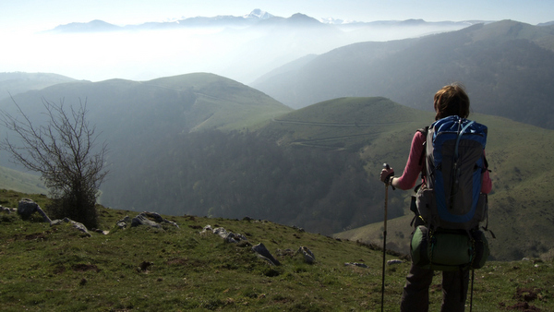
The Pilgrim’s Backpack

Slide 38
3 Strategies for Staying on the Path
How to Redeem
the Worst Parenting Day of Your Life:
BE REDEMPTIVELY ANGRY

Slide 39
Use your mounting frustration,
your anger,
as a signal
to go
“lower, slower, closer.”

Slide 40
LOWER
Lower your voice because you know that yelling, threatening will not help your reach your mission of nurturing life, opening your child’s/ mate’s heart to redemptive change.
Your goal is not victory or dominance.
It is long-term change.

Slide 41
LOWER
Lower your fears---
1. Preach the truth to yourself:
God is the author of your story.
Nothing is too complicated for Him.
2. Remember: Anger comes when you ask your kids, your mate, your parents, etc. to give you what they never will be able to give.
Their compliance, their success, the way they look, act, and treat you---cannot be your basis of well-being in life.
God is the author of your story, and He didn’t give you your children or your mate to build up your sense of identity.
God gave you children to build up HIS reputation---that through the good and bad you would learn to trust that nothing is too complicated for Him.

Slide 42
SLOWER
Slow yourself down—
Breathe deeply, unclench your body.
Go slower b/c you will never be able to deal with a lack of character with a lack of character.
Evaluate your priorities.
Do you need to go into the survival zone?
Pare back what you expect “normal” life should be and have a “new ordinary” which gives you room to slow down.

Slide 43
SLOWER
Slow down your expectations.

Slide 44
CLOSER
Move closer physically—
Don’t withhold yourself as a means of punishment.
Why doesn’t timeout always work?
Try to be as physically close as your child will allow.

Slide 45
CLOSER
Move closer emotionally—
Don’t begin with a lecture.
Begin with a confession:
(1) Repent of any display of your own anger. (2) Acknowledge that you both need God’s help to grow.

Slide 46
CLOSER
Move closer spiritually—
Beating a child or a spouse with guilt does not produce lasting change. Offering hope does.
Share stories, steps, insights, you are learning about how to change.
It could be that the way you move closer spiritually is just to let your child gently know that you are praying for him.

Slide 47
REDEMPTIVE ANGER
Redemptive anger spots the wrong,
but then remembers the Box Top vision:
I am not the Owner of my child.
I am not to be the Anxious Designer of my child.
Instead I am a Trusting Tool in the hand of a God of Grace.

Slide 48
REDEMPTIVE ANGER
Redemptive anger
turns from the fire of self-justification
to humility which can
open the door for a teaching moment
that can transform something ugly
into something beautiful.

Slide 49
The Pilgrim’s Future

Slide 50
Refuse to live with regret--- about the past.

Slide 51
Instead: Live as though what God says is true.
Romans 8:1—Therefore, there is no condemnation to those who are in Christ.
Romans 8:28—When our hearts want to please Jesus, he promises to “work everything together” even our past mistakes---“for good.”
Romans 8: 32 Nothing you do or have done can separate you from God’s love.

Slide 52
Refuse to live with regret— about the present.

Slide 53
Don’t reject the good God offers because you expect some other good.

Slide 54
In our anger, resentment, disappointment,
we can be sulky with God
and refuse the good He wants to give us---
albeit through hard times—
because it was not the good we expected.
In our resentment, we refuse to let God surprise us with His good.

Slide 55
What is the opposite of anger

Slide 56
Gratitude
---the practice of deciding to give thanks,
even when one good was expected,
but another is given
You can’t be angry when you are giving thanks!

Slide 57
The Olympics of Trust

Slide 58
Our mission is to nurture life, and we can do this because Jesus is 24/7 nurturing His life in us,
giving us the desire and power to….
1. Reprogram our minds and hearts with His truth.
2. Trust that we really can change:
He goes lower, slower, closer with us
so that we can with others.
3. Forsake living with regret
because He is the author of our story.

Slide 60
Table Talk
What idea/principle particularly spoke to you?
Why?
In what ways to do you need to go
“lower, slower, closer”?
From your perspective,
what is the opposite of anger?

